Slide 1

Active chat monitoring and suspicious chat detection over internet
PRESENTED BY
G.BHARGAVI
1432J0005
GUIDED BY Mrs. J. VIBA MARY M.Sc., M.Phil.,

Slide 2
SYNOPSIS
The project “Active chat monitoring and suspicious chat detection over internet” aims with the advancement of internet technology and the change in the mode of communication.
Also, the communication channel provides an effective channel for illegal activities such as broadcasting of copyrighted movies, threatening messages and online gambling etc.

Slide 3
EXISTING SYSTEM
The customary examination of Internet chat room dialogs puts an asset trouble due to the time required to screen a huge number of chat sessions.
The admin have to monitor each and every chat sessions which is highly impossible for today’s communication system.

Slide 4
PROPOSED SYSTEM
The system to be developed here is a chat facility.
It is a system with centralized database .
There is two way communications between the client and the server.
This chat application can be used for group discussion.
It allows the user to send feedback to the admin.

Slide 5
SYSTEM SPECFICATION
HARDWARE SPECIFICATION:
Standard PC.
Processor : Core i3
Hard Disk : 160 GB
Memory : 1GB RAM
Monitor
Internet Connection

Slide 6
SOFTWARE SPECIFICATION:
Operating System : Windows7
Front End : HTML, CSS, Bootstrap
Back End : Python 2.7
Database : PostgreSQL
Browser : Google Chrome
Framework : Flask

Slide 7
MODULE DESCRIPTION
ADMIN:
Keywords
View all
Check User
View User
View Feedback
Block
USER:
My details
Chat
Feedback

Slide 8
DATA FLOW DIAGRAMS
USER DETAILS:
ADMIN:

Slide 9
DATA FLOW DIAGRAMS
USER:

Slide 10
KEYWORDS:

Slide 11
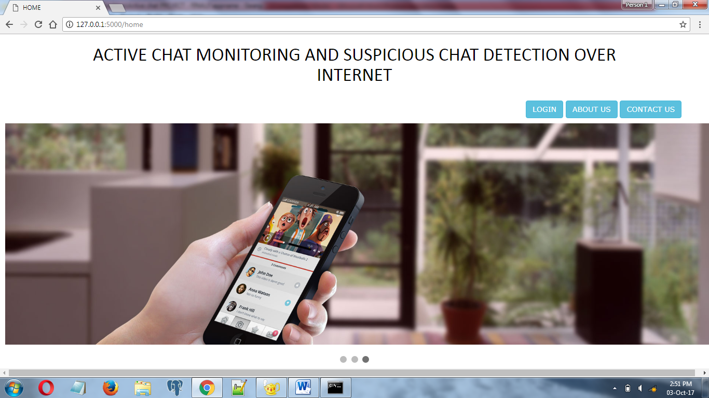
SCREEN SHOTS
HOME PAGE:

Slide 12
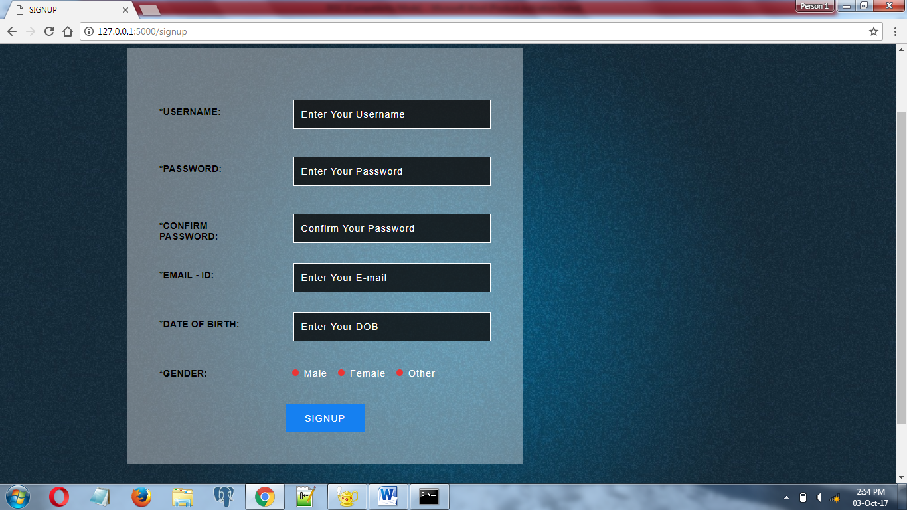
SIGNUP PAGE:

Slide 13
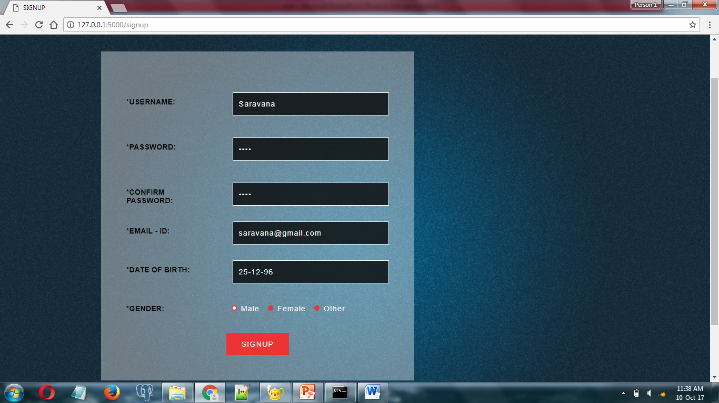

Slide 14
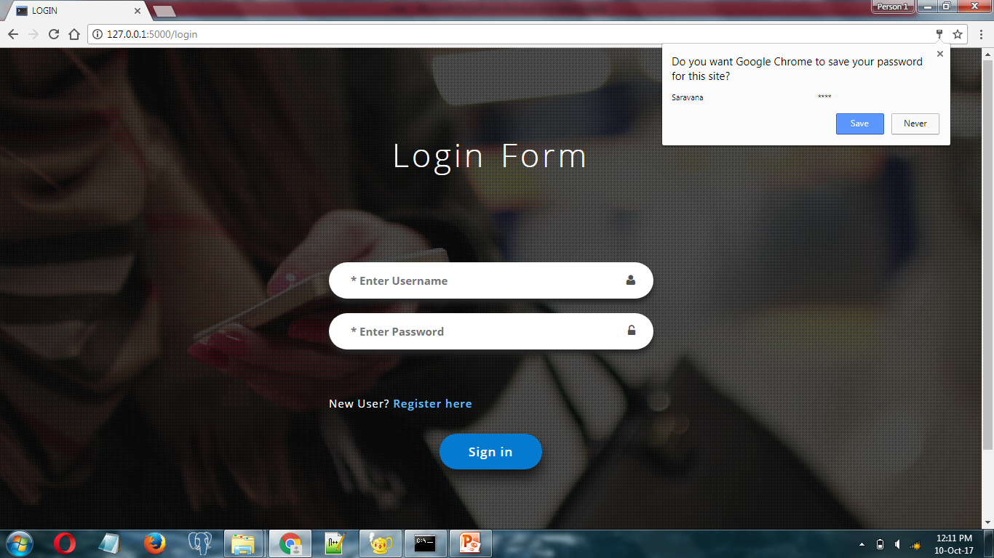

Slide 15
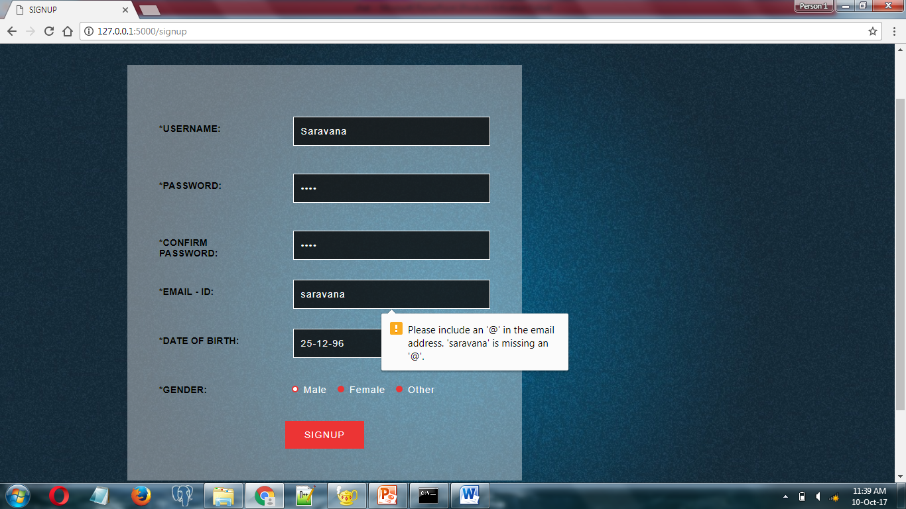

Slide 16
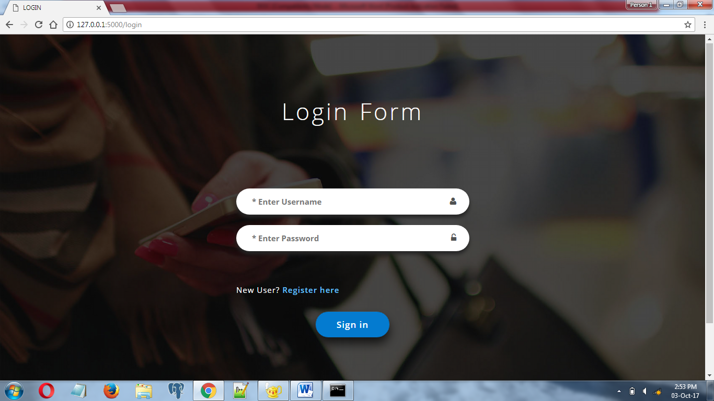
LOGIN PAGE:

Slide 17
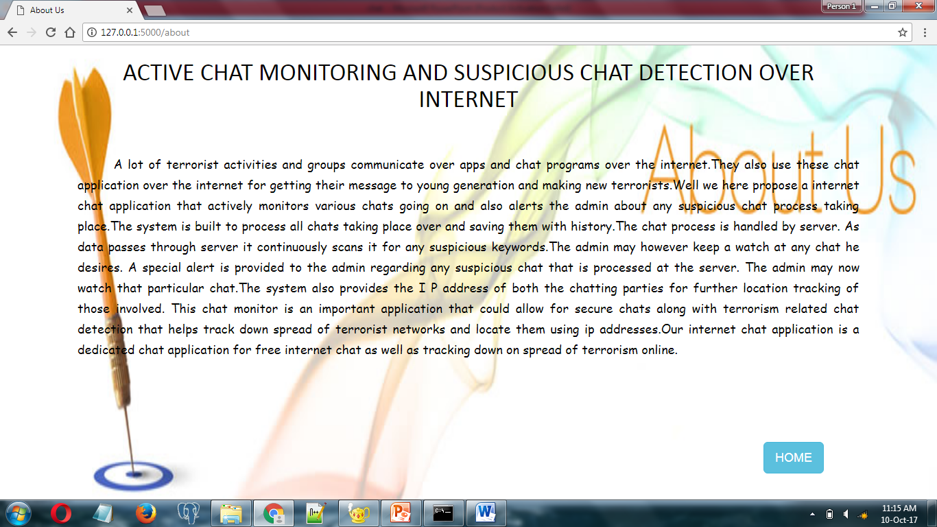
ABOUT US:

Slide 18
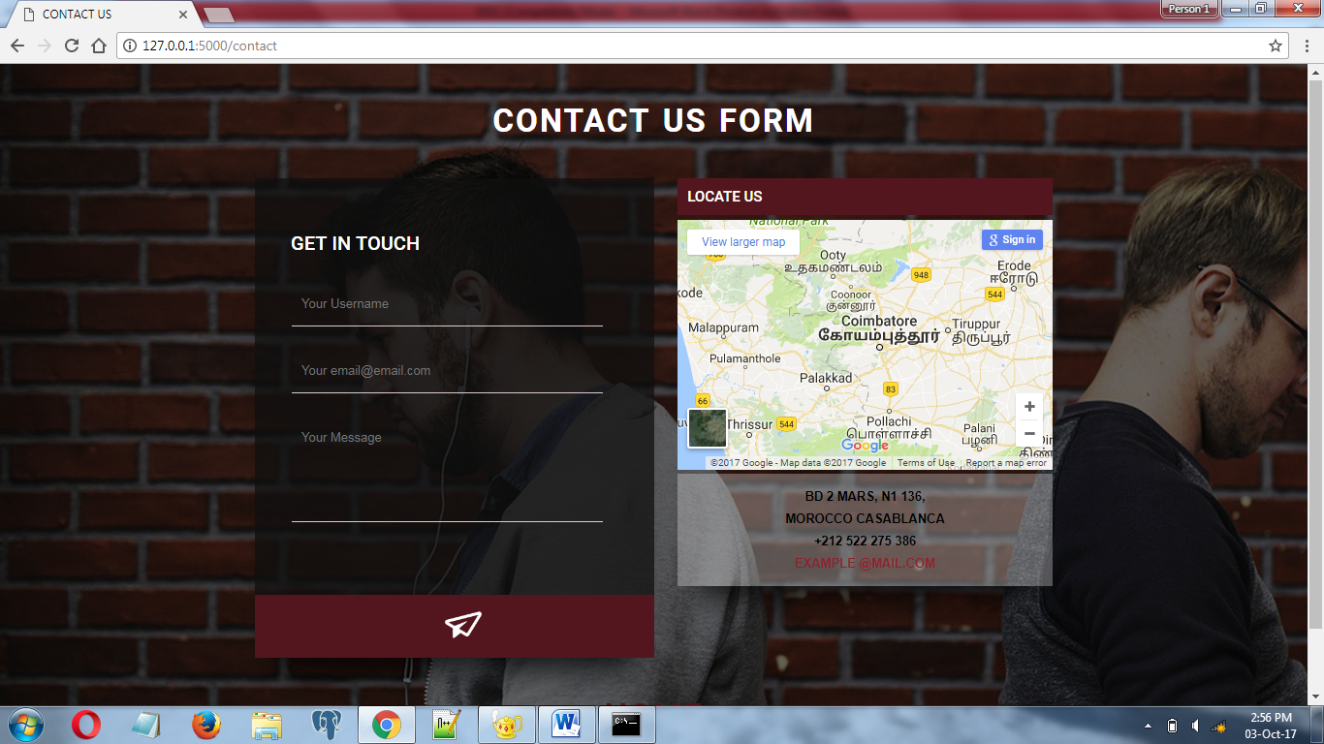
CONTACTUS FORM:

Slide 19
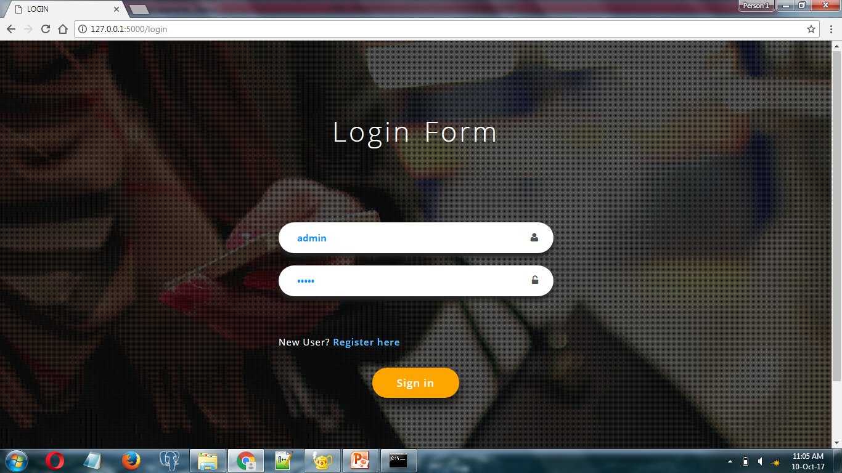
LOGIN : ADMIN LOGIN

Slide 20
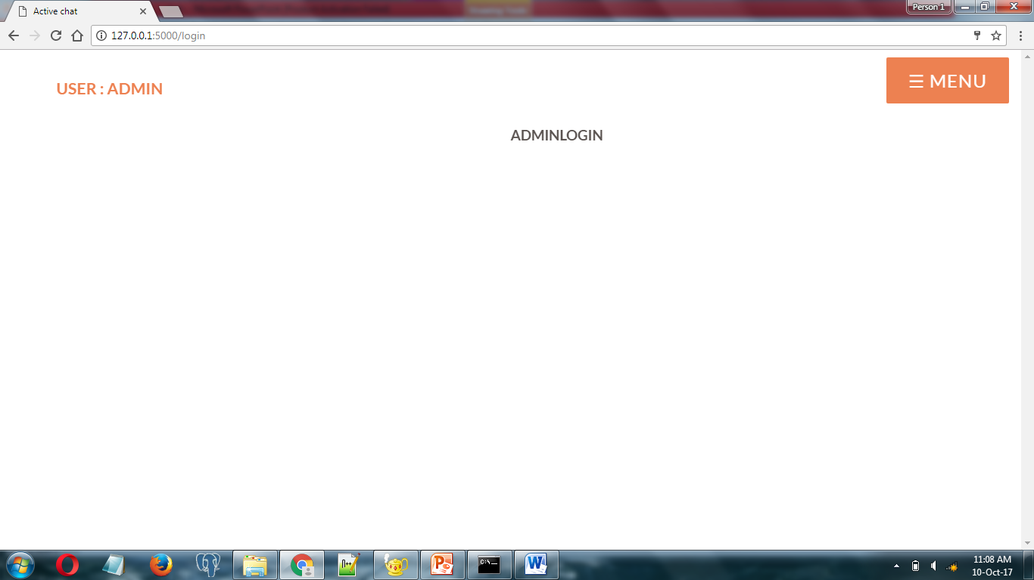
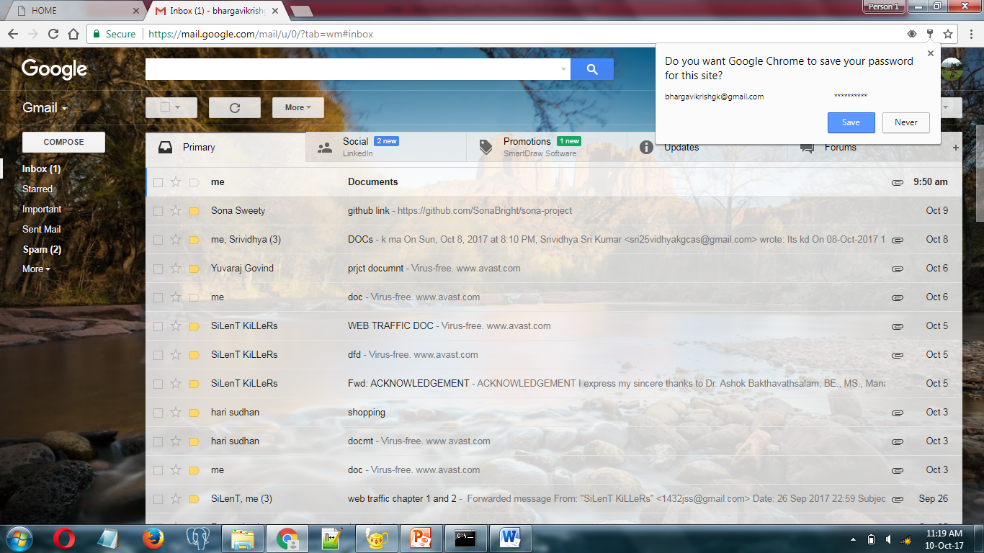
ADMIN HOME

Slide 21
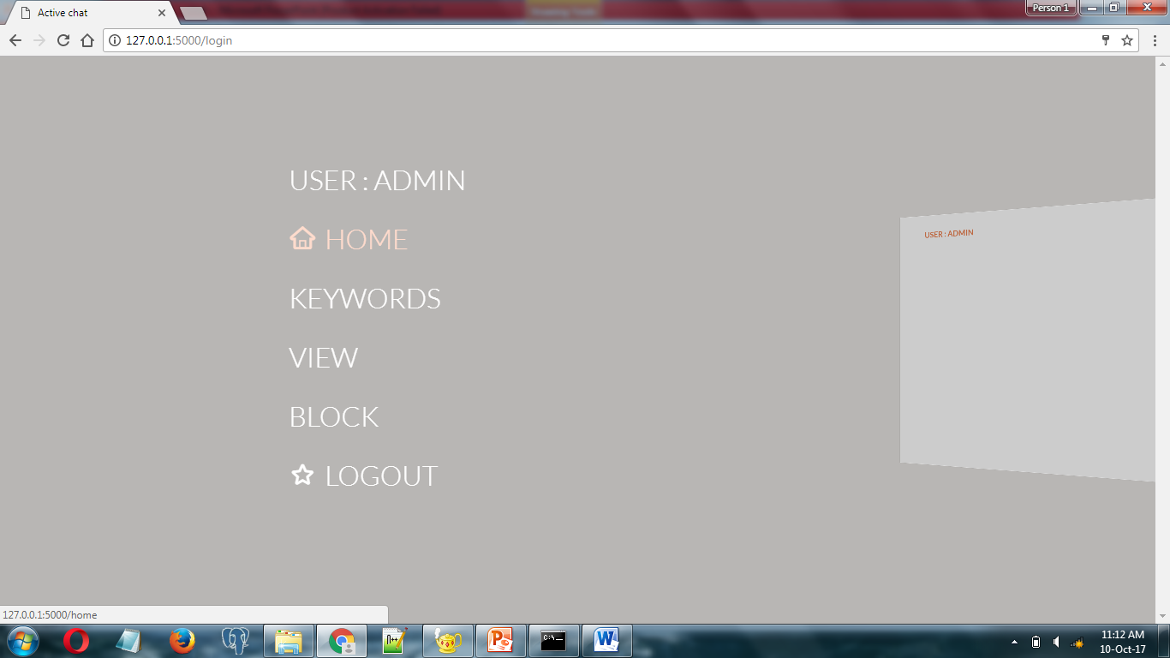
MENU

Slide 22
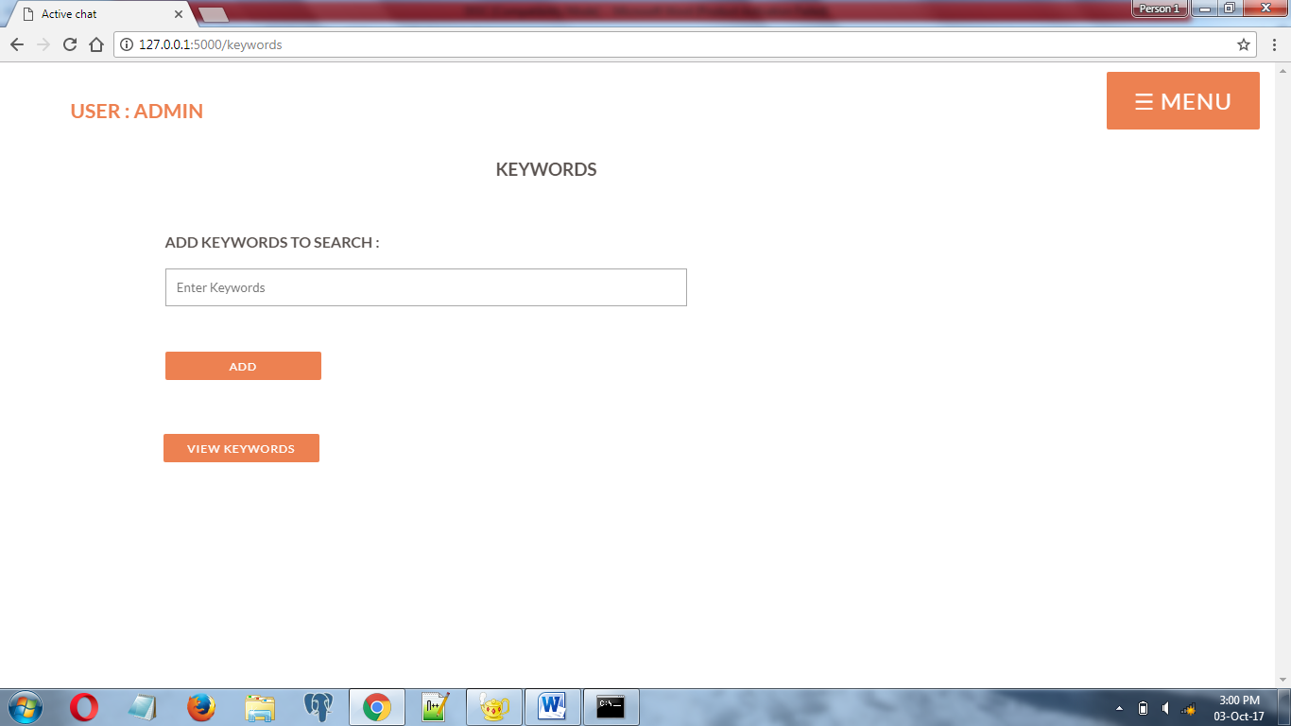
ADMIN VIEW
KEYWORDS PAGE

Slide 23
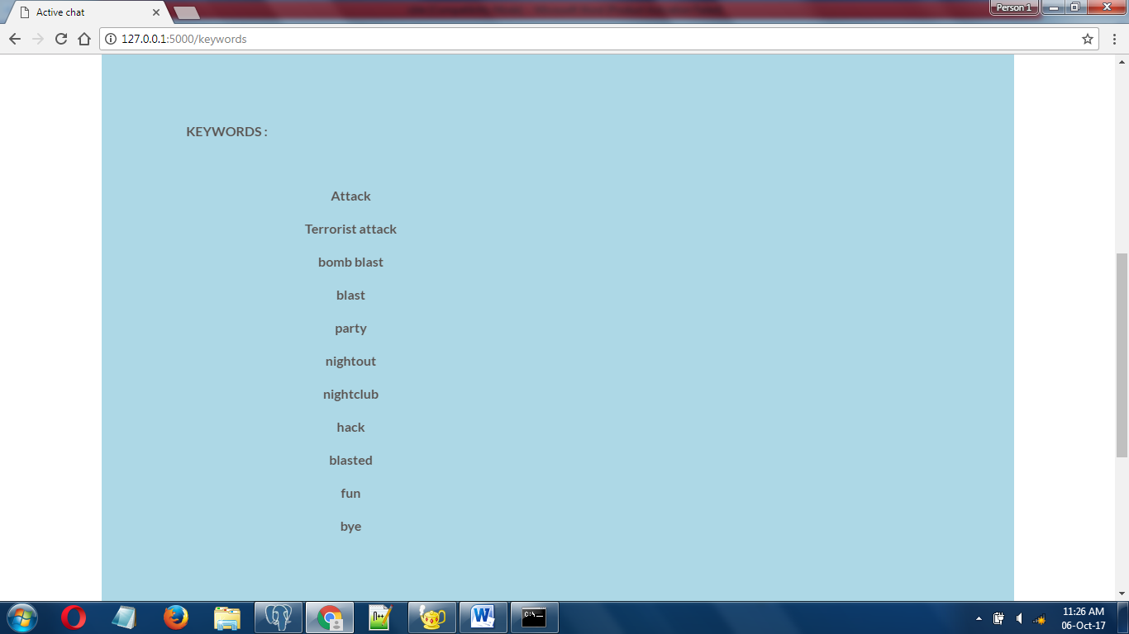
VIEW KEYWORDS

Slide 24
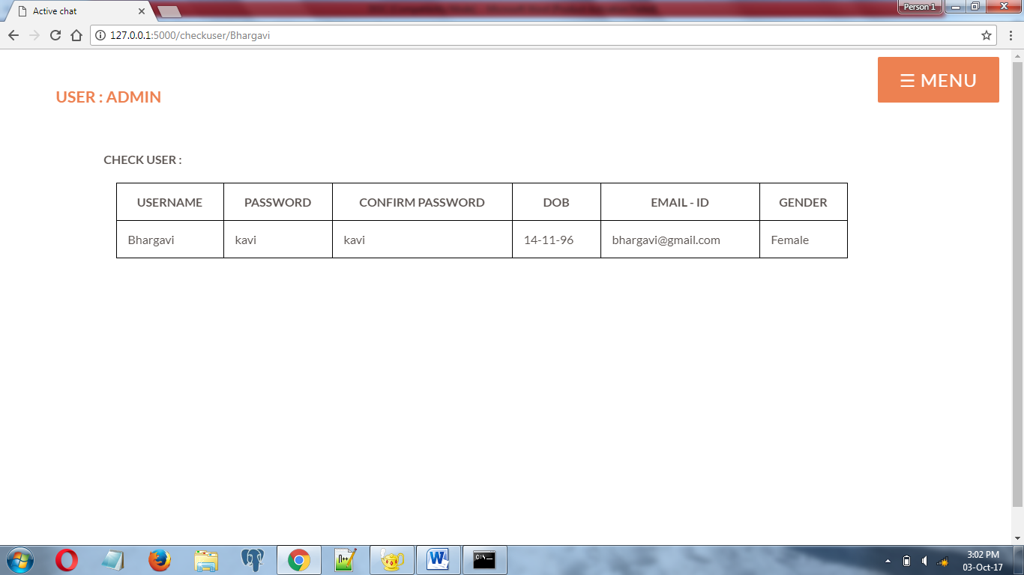
CHECK USER DETAILS

Slide 25
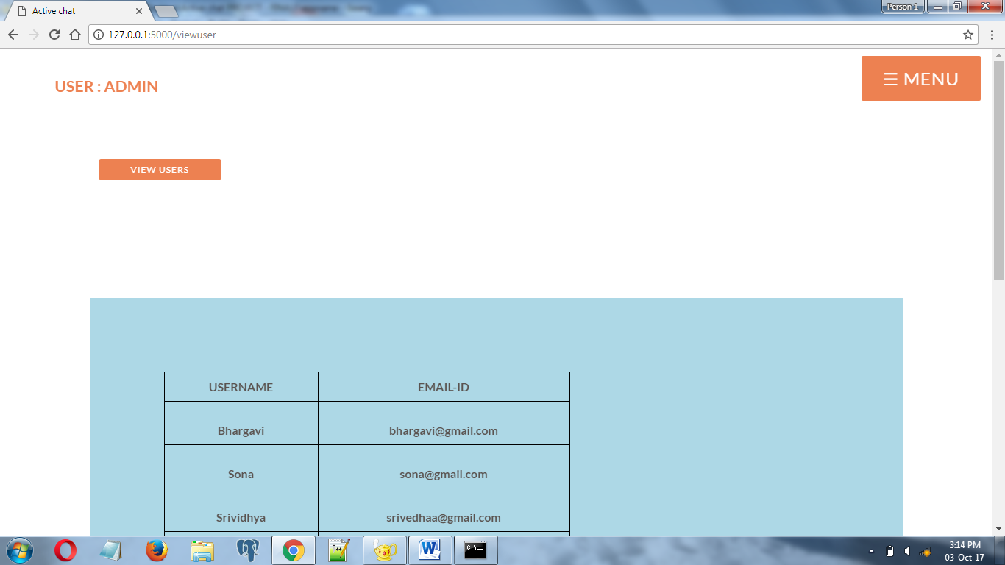
VIEW USER PAGE

Slide 26
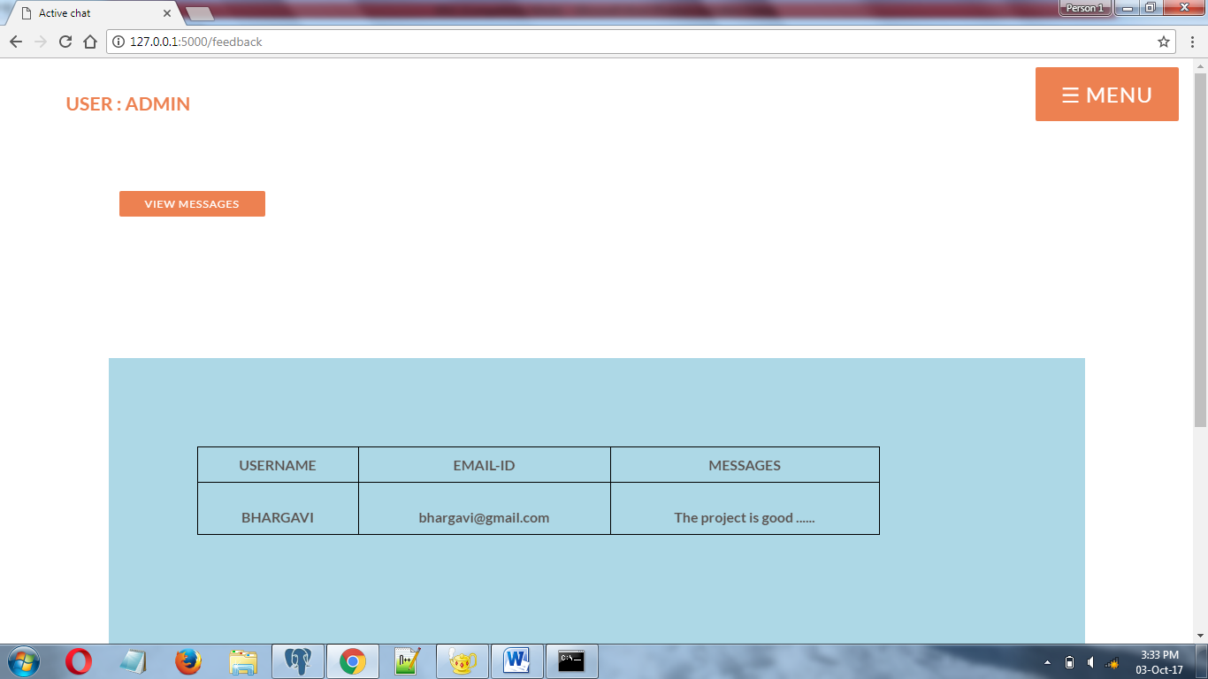
VIEW FEEDBACKS

Slide 27
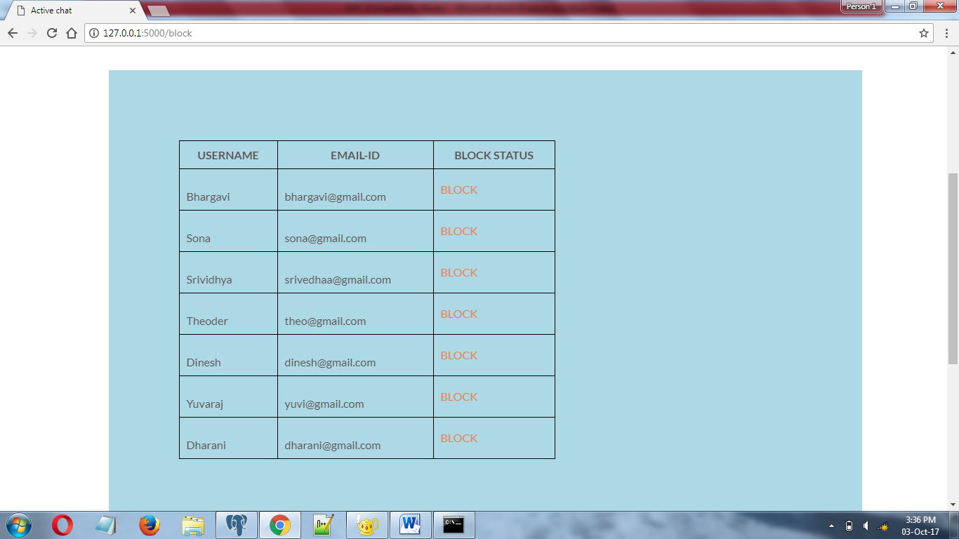
BLOCK PAGE

Slide 28
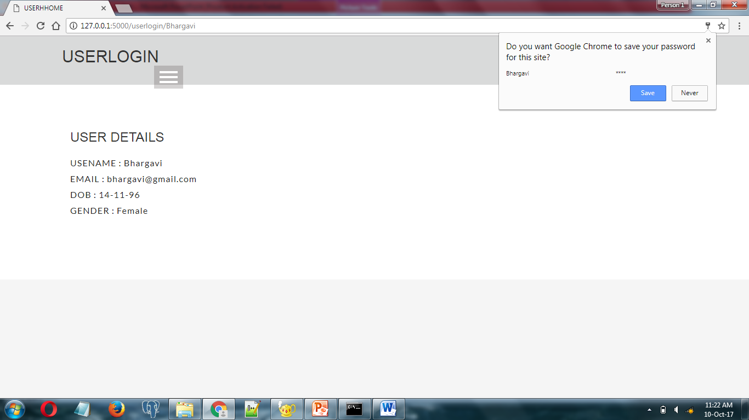
USER HOME

Slide 29
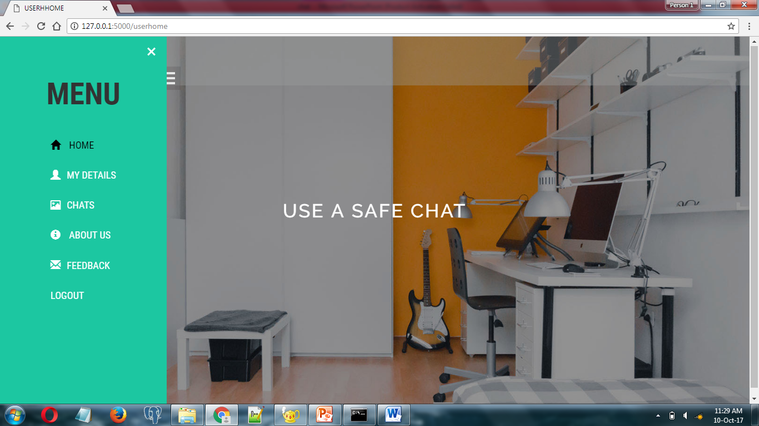

Slide 30
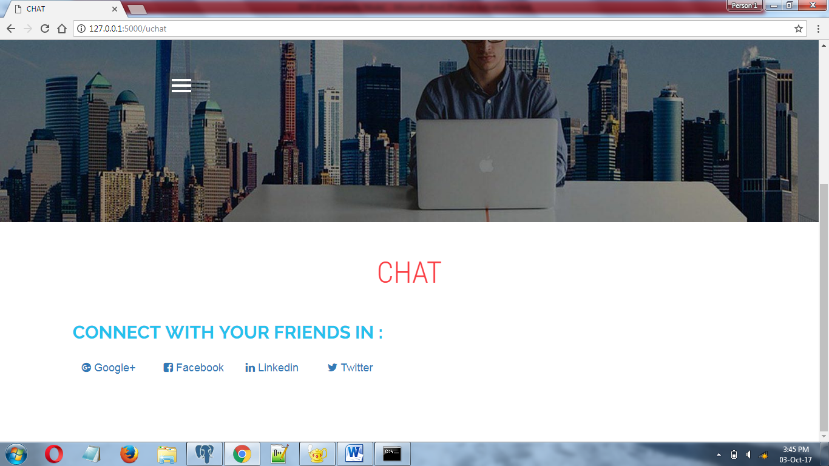
USER VIEW
CHAT

Slide 31
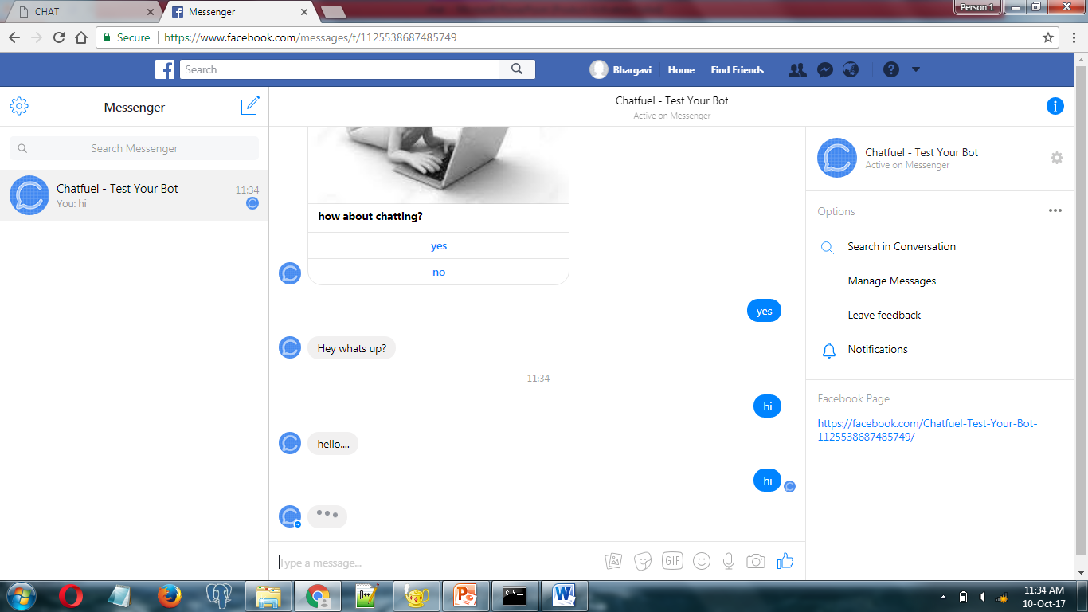

Slide 32
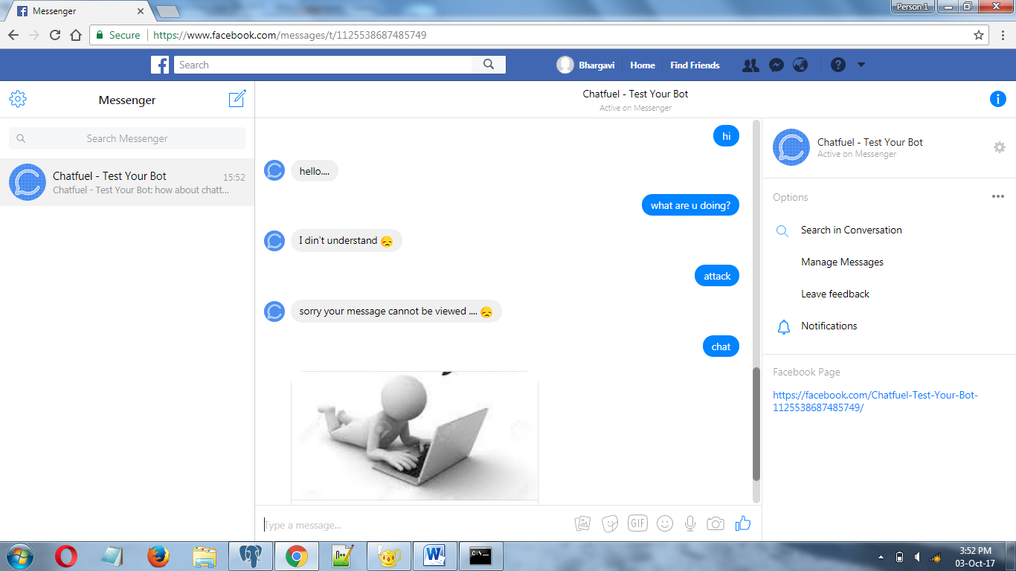

Slide 33
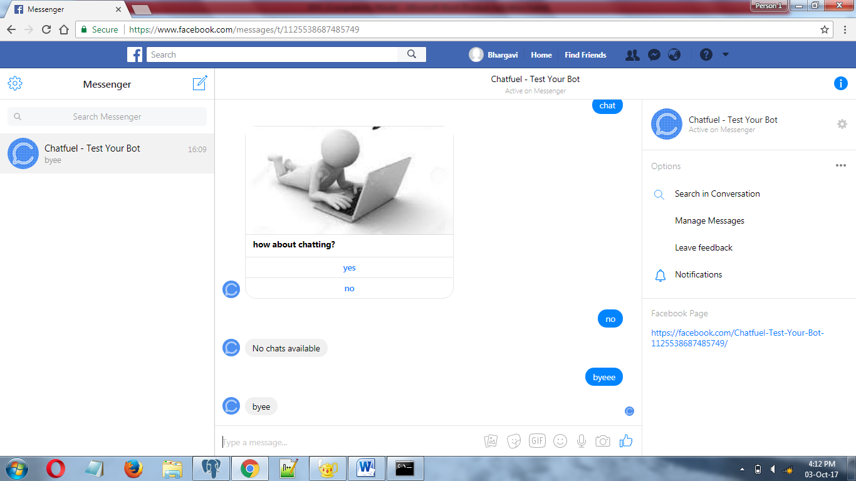

Slide 34
CONCLUSION
By this project, “Active chat monitoring and suspicious chat detection over internet”, I conclude that using a chat for inappropriate conversation provide a secure access over internet without any further monitoring process and secure message passing.

Slide 35
FUTURE ENCHANCEMENT
As the technology emerges, it is possible to upgrade the system and can be adaptable to desired environment.
It is based on object-oriented design, any further changes can be done such like chat secure in group discussion.
Based on the future security issues, security can be improved using emerging technologies.

Slide 36
BIBLIOGRAPHY
TEXTBOOK
“CSS mastery”
Authors : Budd, Andy, Björklund, Emil
Edition : Third edition Publication : Apress
Year : 2016
“HTML and CSS design and build websites”
Authors : Jon Duckett
Edition : first edition
Publication : John Wiley & Sons, 20-Dec-2011
Year : 2011
3. “Python Programming for Beginners: Python Programming Language Tutorial”
Authors : Joseph Joyner
Edition : Second edition
Publication : kindle
Year : 2014

Slide 37
REFERENCES
1. http://www.memoprojects.com/project/active-chat-monitoring-suspicious-chat-detection-internet/
2. http://mashable.com/2012/07/12/facebook-scanning-chats/#uacsCbTAIZqx
3. http://in.nec.com/en_IN/images/140125.pdf
4. https://www.gitbook.com/book/towcenter/guide-to-chat-apps/details
5. https://www.ijariit.com/manuscripts/v3i1/V3I1-1332.pdf

Slide 38

Thank You!!

